Slide 1
PROBABILITY AND DISTRIBUTION
It is a part of Probability that many improbable things will happen
- Aristotle
Dhrub Satyam (Data Scientist)

Slide 2





PROBABILITY
Probability implies 'likelihood' or 'chance'. When an event is certain to happen then the probability of occurrence of that event is 1 and when it is certain that the event cannot happen then the probability of that event is 0.
Hence the value of probability ranges from 0 to 1.
Classical Definition of Probability
As the name suggests the classical approach to defining probability is the oldest approach. It states that if there are n exhaustive, mutually exclusive and equally likely cases out of which m cases are favourable to the happening of event A,
Then the probabilities of event A is defined as given by the following probability function:

Slide 3








PROBABILITY
Example
Problem Statement:
A coin is tossed. What is the probability of getting a head?
Solution:
Number of outcomes favourable to head (m) = 1
Total number of outcomes (n) = 2 (i.e. head or tail)

Slide 4











PROBABILITY - Basic Concepts
Random Experiment
An experiment is said to be a random experiment, if it's out-come can't be predicted with certainty.
Example
If a coin is tossed, we can't say, whether head or tail will appear. So it is a random experiment.
Sample Space
The set of all possible out-comes of an experiment is called the sample space. It is denoted by 'S' and its number of elements are n(s).
Example
In throwing a dice, the number that appears at top is any one of 1,2,3,4,5,6. So here:
S ={1,2,3,4,5,6} and n(s) = 6
Similarly in the case of a coin, S={Head,Tail} or {H,T} and n(s)=2.

Slide 5




















PROBABILITY - Basic Concepts
Event
Every subset of a sample space is an event. It is denoted by 'E'.
Example
In throwing a dice S={1,2,3,4,5,6}, the appearance of an even number will be the event E={2,4,6}.
Clearly E is a sub set of S.

Slide 6











PROBABILITY - Basic Concepts
Equally likely events
Events are said to be equally likely, if the probability of occurrence of the events are same.
Example
When a dice is thrown, all the six faces {1,2,3,4,5,6} are equally likely to come up.
Exhaustive events
When every possible out come of an experiment is considered.
Example
A dice is thrown, cases 1,2,3,4,5,6 form an exhaustive set of events.

Slide 7











Slide 8






PROBABILITY - Basic Concepts
Mutually exclusive or Disjoint event
If two or more events can't occur simultaneously,
that is no two of them can occur together.
Example
When a coin is tossed, the event of occurrence of a head and the event of occurrence of a tail are mutually exclusive events.
Independent or Mutually independent events
Two or more events are said to be independent if occurrence or non-occurrence of any of them does not affect the probability of occurrence or non-occurrence of the other event.
Example
When a coin is tossed twice, the event of occurrence of head in the first throw and the event of occurrence of head in the second throw are independent events.
Difference between mutually exclusive and mutually independent events
Mutually exclusiveness is used when the events are taken from the same experiment, where as independence is used when the events are taken from different experiments.

Slide 9

























Additive theorem of probability
For Non Mutually Exclusive Events
Statement: If A and B are not mutually exclusive events, the probability of the occurrence of either A or B or both is equal to the probability that event A occurs, plus the probability that event B occurs minus the probability of occurrence of the events common to both A and B. In other words the probability of occurrence of at least one of them is given by
For Mutually Exclusive Events
Statement: If A and B are two mutually exclusive events, then the probability of occurrence of either A or B is the sum of the individual probabilities of A and B. Symbolically

Slide 10





Additive theorem of probability - Examples
For Non Mutually Exclusive Events
A shooter is known to hit a target 3 out of 7 shots; whereas another shooter is known to hit the target 2 out of 5 shots. Find the probability of the target being hit at all when both of them try.
2. In a math class of 30 students, 17 are boys and 13 are girls. On a unit test, 4 boys and 5 girls made an A grade. If a student is chosen at random from the class, what is the probability of choosing a girl or an A student?
For Mutually Exclusive Events
A card is drawn from a pack of 52, what is the probability that it is a king or a queen?
A single 6-sided die is rolled. What is the probability of rolling a 2 or a 5?

Slide 11
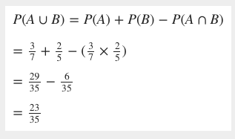
















Solutions - 1
Probability of first shooter hitting the target P (A) = 3/7
Probability of second shooter hitting the target P (B) = 2/5
Event A and B are not mutually exclusive as both the shooters may hit target. Hence the additive rule applicable is

Slide 12
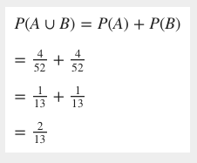
Solutions - 2
Let Event (A) = Draw of a card of king
Event (B) Draw of a card of queen
P (card draw is king or queen) = P (card is king) + P (card is queen)

Slide 13

















Multiplicative theorem of probability
For Independent Events
Statement: The theorem states that the probability of the simultaneous occurrence of two events that are independent is given by the product of their individual probabilities.
For Dependent Events (Conditional Probability)
If we recall dependent event(), the earlier stated multiplicative theorem is not applicable for dependent events. For dependent event, we have an another theorem called the conditional probability which is given as:
The probability of event B given event A equals the probability of event A and event B divided by the probability of event A

Slide 14
MULTIPLICATIVE THEOREM/CONDITIONAL PROBABILITY - EXAMPLES
Independent Event: You have a cowboy hat, a top hat, and an Indonesian hat called a songkok. You also have four shirts: white, black, green, and pink. If you choose one hat and one shirt at random, what is the probability that you choose the songkok and the black shirt?

Slide 15


MULTIPLICATIVE THEOREM/CONDITIONAL PROBABILITY - EXAMPLES
Independent Event: You have a cowboy hat, a top hat, and an Indonesian hat called a songkok. You also have four shirts: white, black, green, and pink. If you choose one hat and one shirt at random, what is the probability that you choose the songkok and the black shirt?
The two events are independent events; the choice of hat has no effect on the choice of shirt.
There are three different hats, so the probability of choosing the songkok is 1/3 .
There are four different shirts, so the probability of choosing the black shirt is 1/4.
So, by the Multiplication Rule:
P(songkok and black shirt)=(1/3)⋅(1/4)=1/12

Slide 16
















MULTIPLICATIVE THEOREM/CONDITIONAL PROBABILITY - EXAMPLES
Dependent Event: An urn contains 20 red and 10 blue balls. Two balls are drawn from a bag one after the other without replacement. What is the probability that both the balls drawn are red?

Slide 17
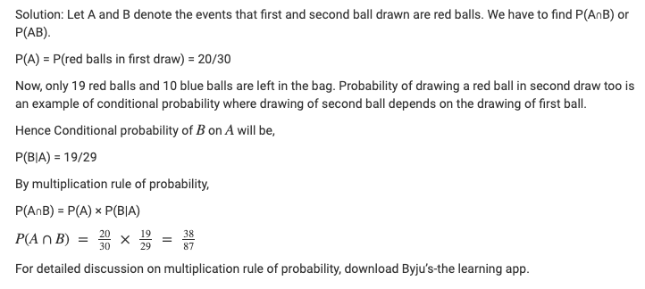


MULTIPLICATIVE THEOREM/CONDITIONAL PROBABILITY - EXAMPLES
Dependent Event: An urn contains 20 red and 10 blue balls. Two balls are drawn from a bag one after the other without replacement. What is the probability that both the balls drawn are red?

Slide 18
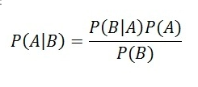



























Bayes Theorem
Named after Thomas Bayes
Bayes' Theorem describes the probability of an event, based on prior knowledge of conditions that might be related to the event.
Note: This conditional probability is known as a hypothesis. This hypothesis is calculated through previous evidence or knowledge. This conditional probability is the probability of the occurrence of an event, given that some other event has already happened.
Example:
Suppose the weather of the day is cloudy. Now, you need to know whether it would rain today, given the cloudiness of the day. Therefore, you are supposed to calculate the probability of rainfall, given the evidence of cloudiness.

Slide 19












Bayes Theorem – From where it came?
We know from Conditional Probability:
Since
Hence,
Rearranging Equation 1:
=
*
Similarly:
=
*
=
Finally:

Slide 20
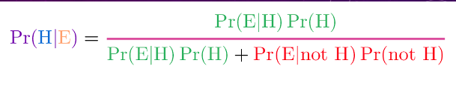














Bayes Theorem – Generalized Form?

Slide 21

Bayes Theorem - Examples
Epidemiologists claim that the probability of breast cancer among Caucasian women in their mid 50s is 0.005. An established test identified people who had breast cancer and those that were healthy. A new mammography test in clinical trials has a probability of 0.85 for detecting cancer correctly. In women without breast cancer, it has a chance of 0.925 for a negative result. If a 55-year-old Caucasian woman tests positive for breast cancer, what is the probability that she, in fact, has breast cancer?

Slide 22
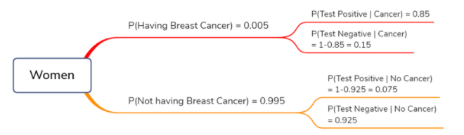
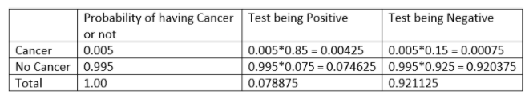






Bayes Theorem - Examples
Epidemiologists claim that the probability of breast cancer among Caucasian women in their mid -50s is 0.005. An established test identified people who had breast cancer and those that were healthy. A new mammography test in clinical trials has a probability of 0.85 for detecting cancer correctly. In women without breast cancer, it has a chance of 0.925 for a negative result. If a 55-year-old Caucasian woman tests positive for breast cancer, what is the probability that she, in fact, has breast cancer?
Solution:
P(Cancer) = 0.005
P(Test Positive | Cancer) = 0.85
P(Test -ve|No cancer) = 0.925
P(Cancer|Test +ve)= P(Cancer) * P(Test Positive | Cancer) / P(Test Positive)

Slide 23

Bayes Theorem - Examples
Symantec works by having users train the system. It looks for patterns in the words in emails marked as spam by the user. For example, it may have learned that the word “free” appears in 20% of the emails marked as spam. Assuming 0.1% of non-spam mail includes the word “free” and 50% of all emails received by the user is spam, find the probability that a mail is a spam if the word “free” appears in it.
Solution:

Slide 24




Bayes Theorem - Examples
Symantec works by having users train the system. It looks for patterns in the words in emails marked as spam by the user. For example, it may have learned that the word “free” appears in 20% of the emails marked as spam. Assuming 0.1% of non-spam mail includes the word “free” and 50% of all emails received by the user is spam, find the probability that a mail is a spam if the word “free” appears in it.
Solution:

Slide 25










